Slide 1
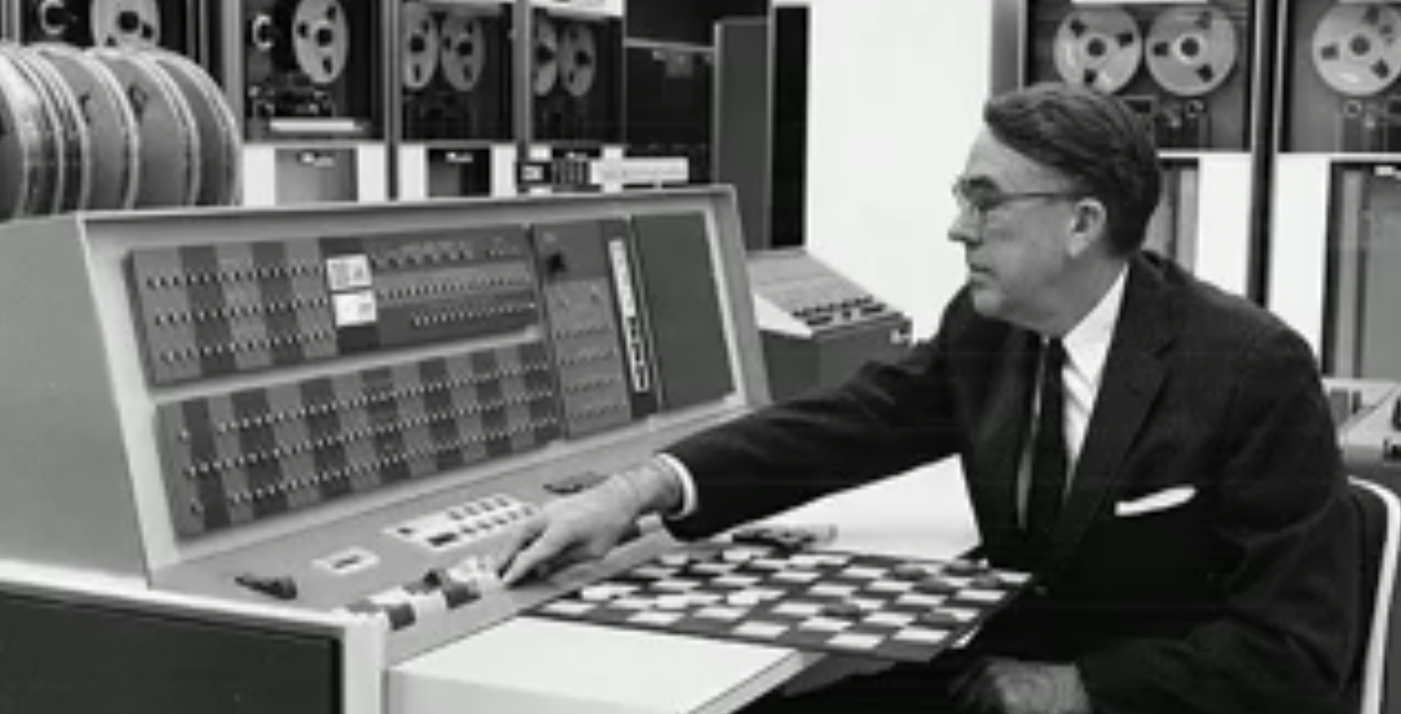
Arthur Samuel

Slide 2
Father of Machine learning 1956 – Trains computer to play checkers 1962 – Computer defeated the state champion

Slide 3
Example isn’t another way to teach, it is the only way to teach
-Albert Einstein

Slide 4
What Machine learning did in past and doing today and in future

Slide 5
PROBLEM SET
A Specific metallic component is wearing out with use in an acidic environment
How do we understand and use this component?

Slide 6
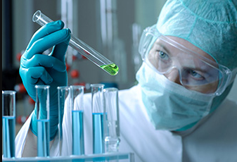
Approach 1: Science
A chemist studies what happens to the material in acid and
understands that the metal is reacting with the hydrogen in the
acid to form a vapor
Comes up with a equation and science behind

Slide 7
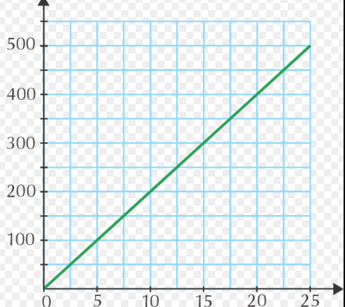
Approach 2: Engineering
An engineer tests the degradation in a few concentrations and
temperature, plots the degradation, validate the theory and
comes up with the thumbs up rule

Slide 8
Deductive learning
A few hypothesis that cannot be proved
Rest of science is developed by extending these using mathematics
and experiments

Slide 9
Inductive Learning
Measure the degradations in hundreds of conditions (temperatures and concentrations for various times)

Slide 10
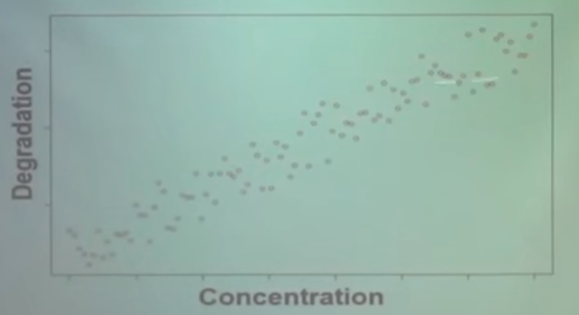

Slide 11
Result is same but
Do not know the reasons(causations are not known and only correlations are identified)
Walmart example(does not tell how to act)
Marketing customer(does not tell the reason)

Slide 12
Where it does not work
Fails when randomness prevails
Need a lot of data to come to the correct conclusions

Slide 13
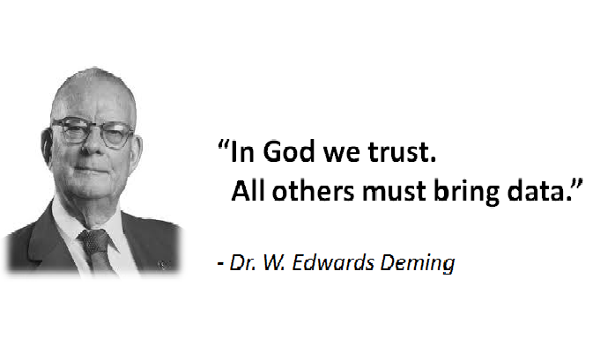

Slide 14
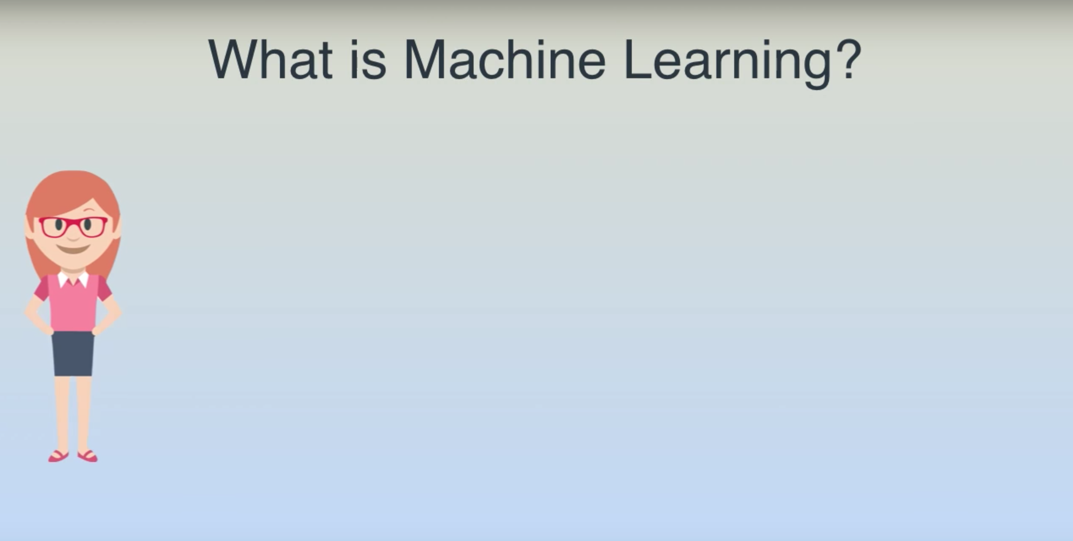

Slide 15
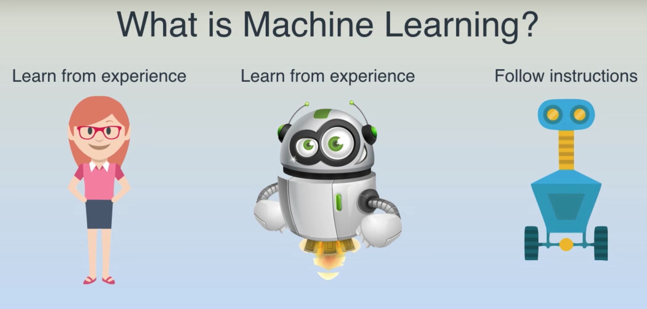

Slide 16
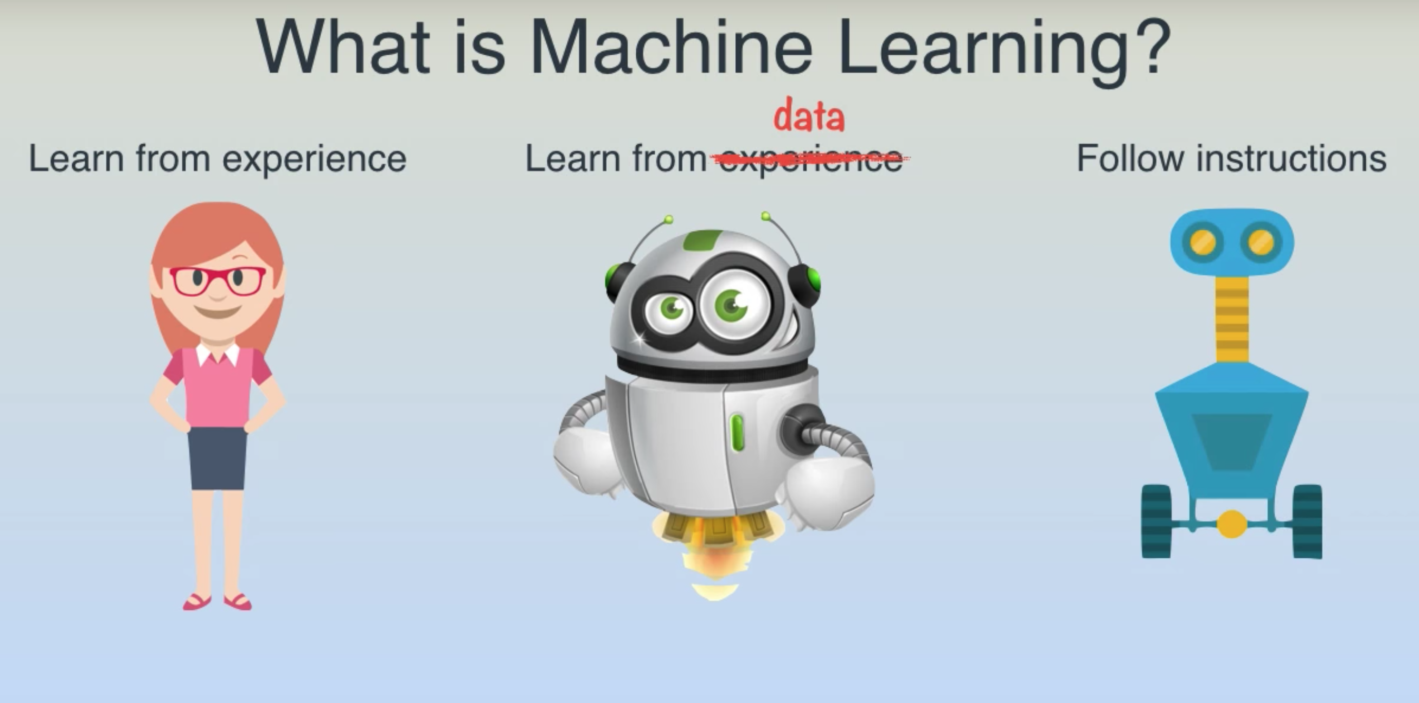

Slide 17
Find the house price?

Slide 18
Traditional Way
def detect_houseType():
#lots of code
def detect_houseStandard():
#lots of code
def define_standards():
#lots of code
def define_type():
#lots of code
……………….
……………….
……………….
def findPrice(city, yearBuilt, bedrooms, bathrooms , squareFeet, floors):
if(city==“A”):
#lots of code
elif(city == “B”):
#lots of code
elif(city == “C”):
#lots of code
……………………..
……………………..
……………………..
Collecting Data
City
Year Built
Floors
Bedrooms
Bathrooms
Square-foot
Business Logic
Analyze
Brainstorm
Design
Build the application
Notes:
Requirement changes,
Rules,
Government regulation
Another system
Maintenance
Flop

Slide 19
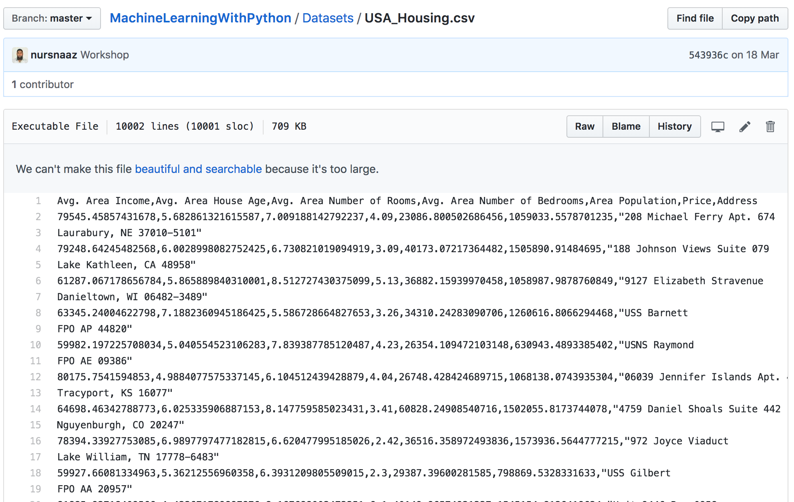
Machine Learning way
Give lots of Example to a function

Slide 20
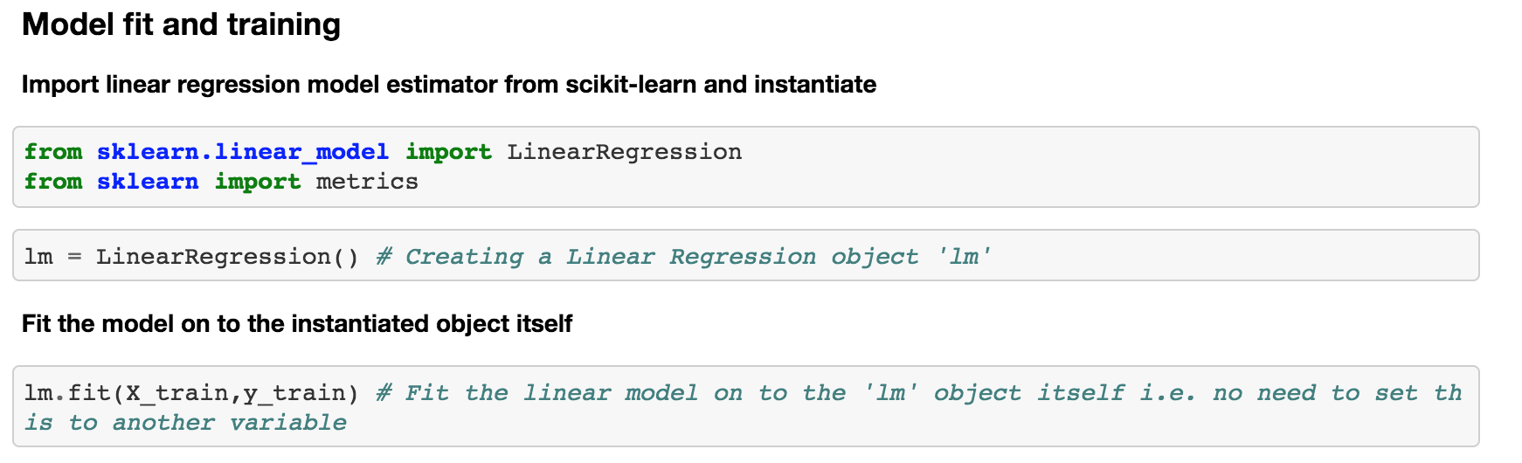
Run Machine Learning Algorithm
Algorithm doesn’t know business
By Sophisticated Mathematic process
Will figure out the logic behind it

Slide 21
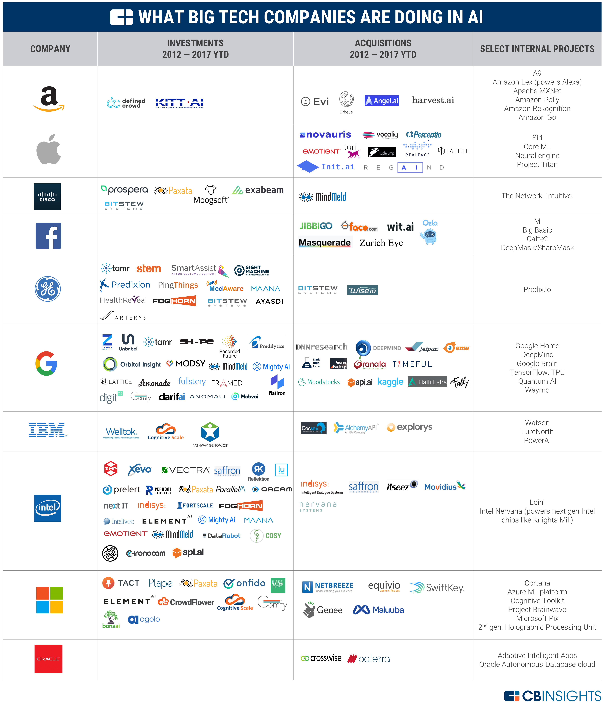
Notes:
Google, Amazon Recommendation, Facebook Recommendation, Linkedin Recomendation, Netflix Recommendation

Slide 22
What Machine Learning can do to Logitech?

Slide 23
Increasing the profit

Slide 24
Operational Efficiency

Slide 25
Increased Customer Service

Slide 26
Decreasing the Unnecessary cost

Slide 27
Why Now?

Slide 28
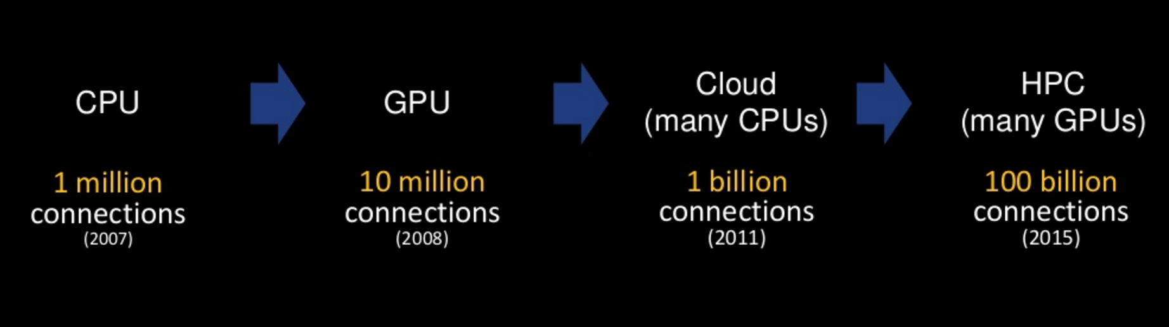
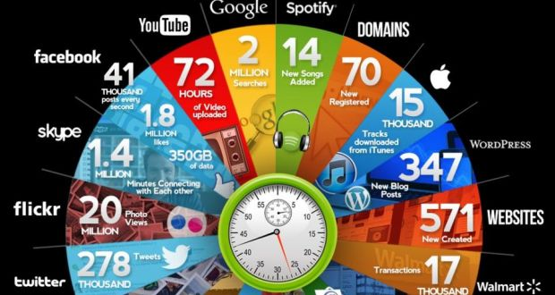
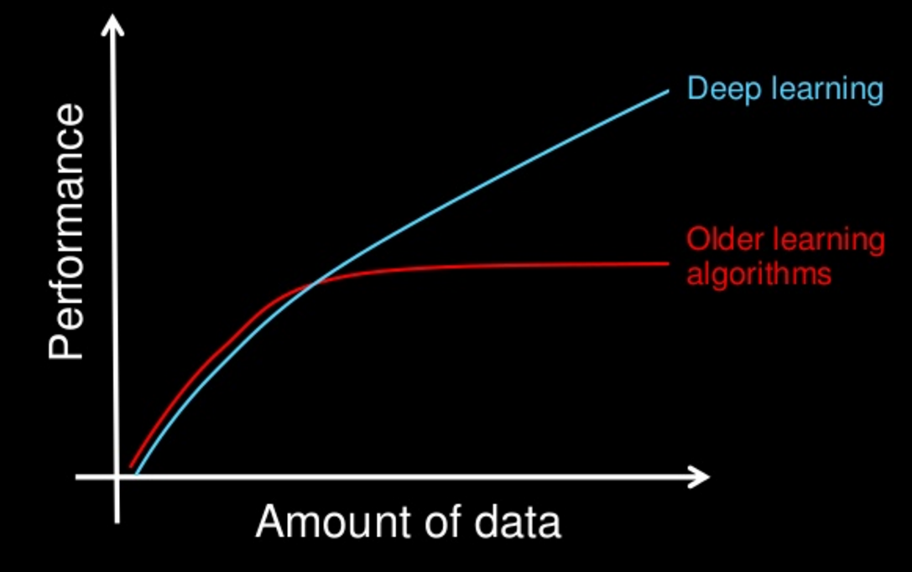
What Happened in the year 2000 – 2016?
Compute Power
2010 to 2016
Data Volume
Deep Learning
Algos
Notes:
Big Data, Computation, IOT Data, Cloud Computing

Slide 30
Logitech Data as a Glimpse
Inception – 1982
We have sold more than 700 million mice
Logitech has sold more than 100 million cordless mice and keyboards
By March 2006 - Introduced more than 130 new products and shipped more than 143 million products worldwide.

Slide 31
Consequence of Not Adopting Technology
Competitive Analysis
Predictive Analysis
Not ready for the future
Vulnerable to fade off

Slide 32
What we have done?

Slide 33
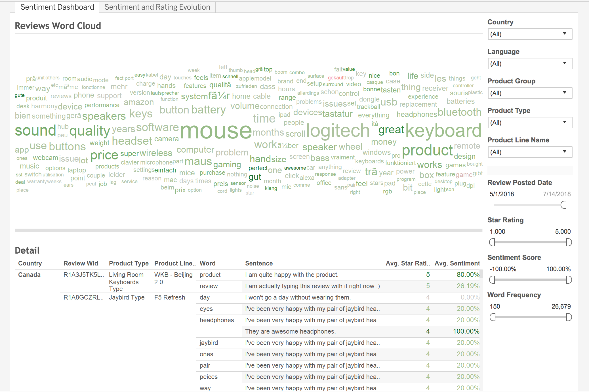
Amazon Sentiment Analysis
https://tableau.logitech.com/#/site/Logitech/views/WordCloudAmazonReviews/SentimentDashboard?:iid=1
Objective : Increased Customer Service
Notes:
Proactive support

Slide 34
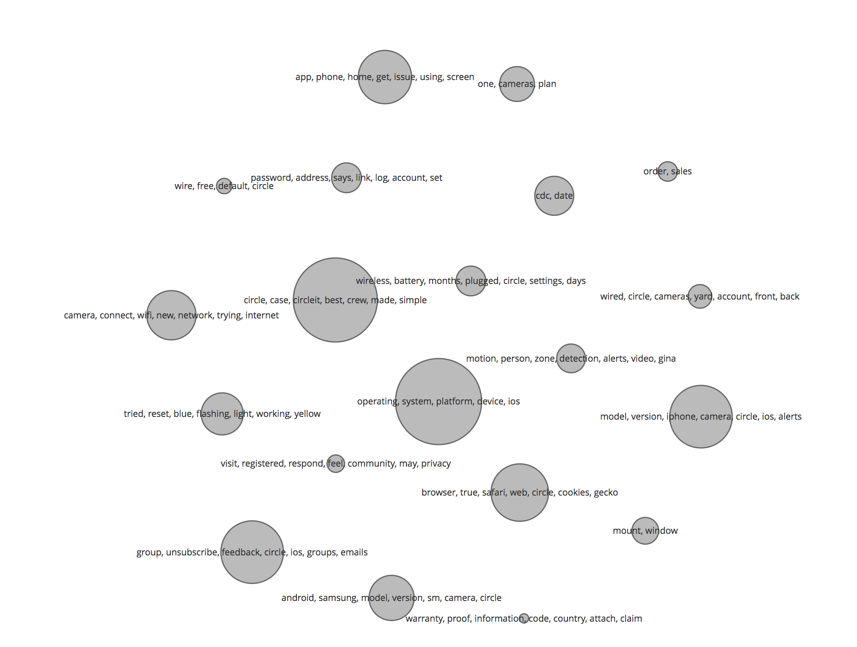
Topic Modelling
http://localhost:2030/topic_cloud.html
Objective : Operational Efficiency
Notes:
Proactive support

Slide 35
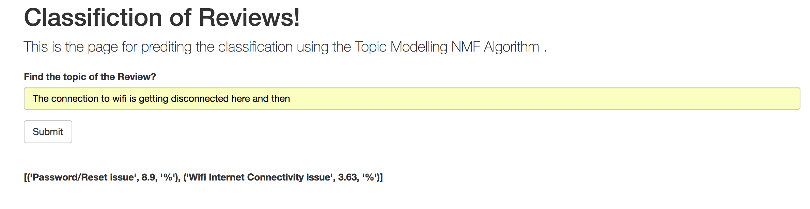
Topic Model Prediction
Notes:
Proactive support

Slide 36
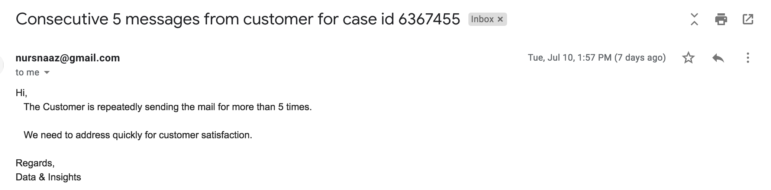
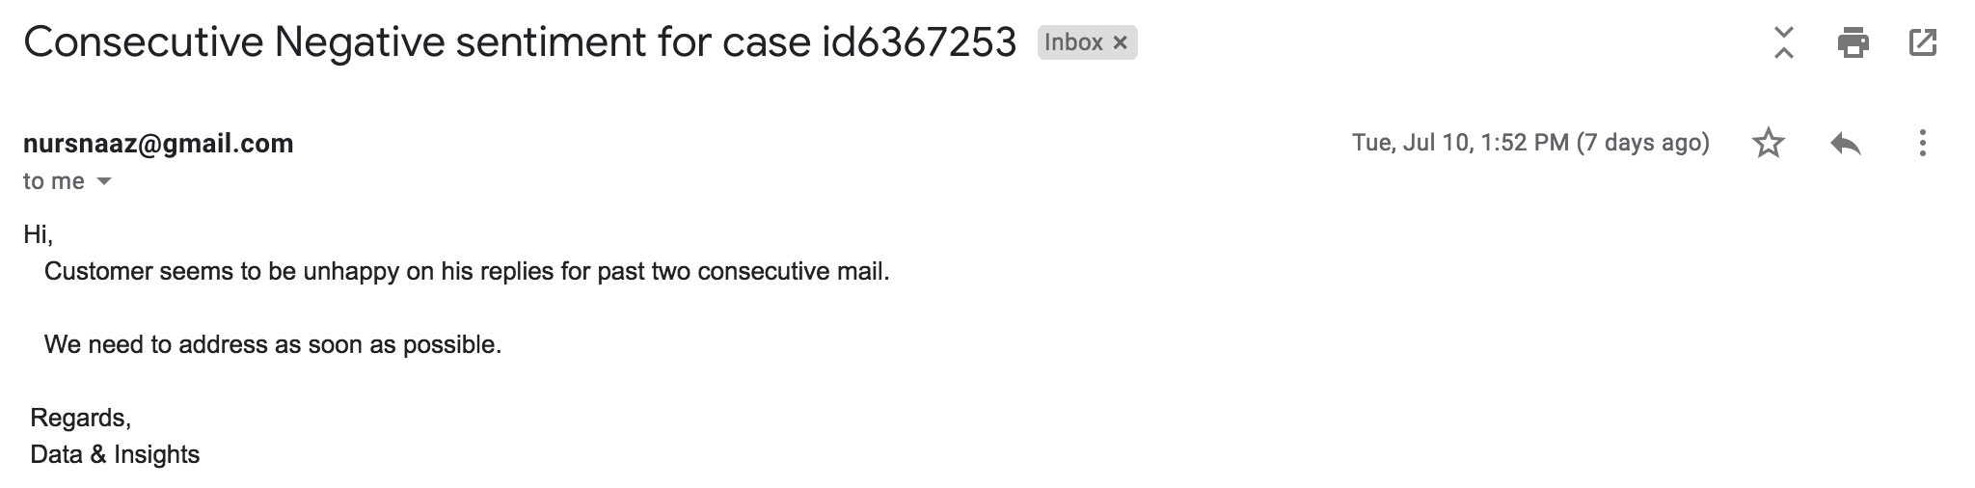
Customer care sentiment
Objective :
Increased Customer Service
Operational Efficiency
Notes:
Proactive support

Slide 37
Take Away!!!
Ponder on the Importance of Data Science Team.
What it solves?
Core of organisation.
Works Horizontal in global.
Start thinking how u can use data science applicable?

Slide 38
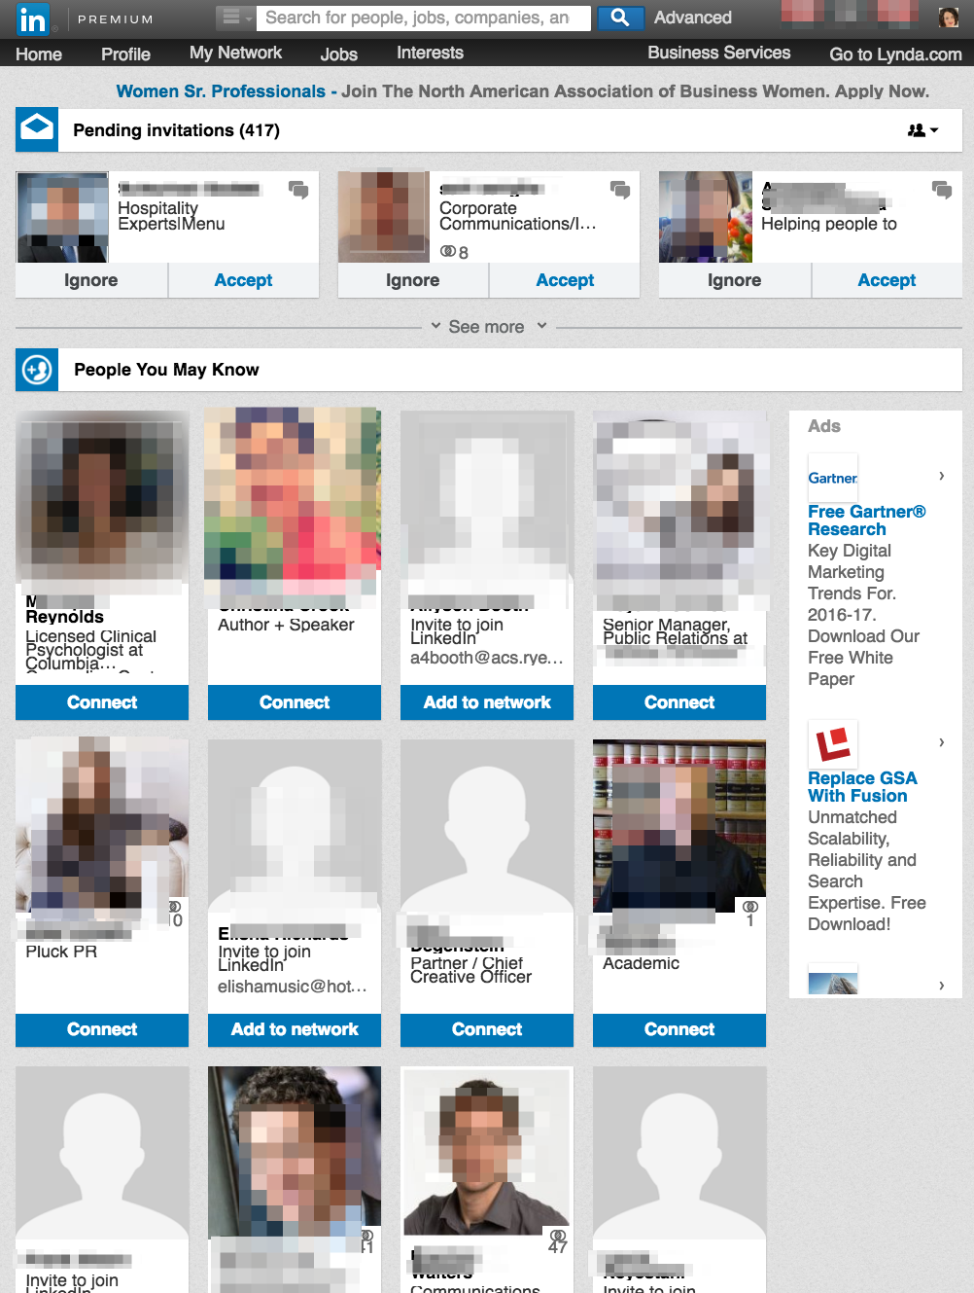
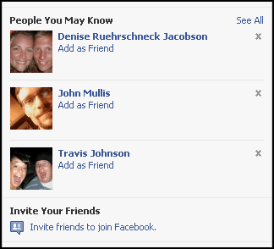

Slide 39
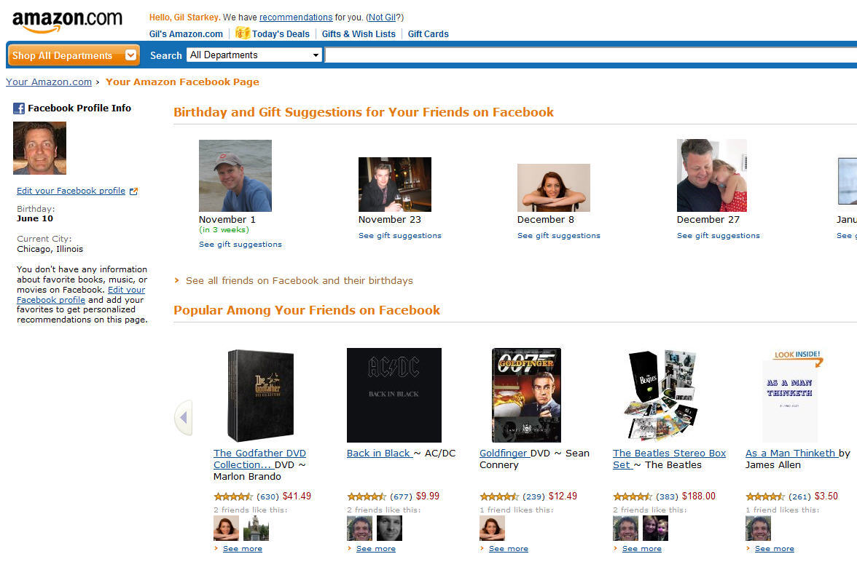
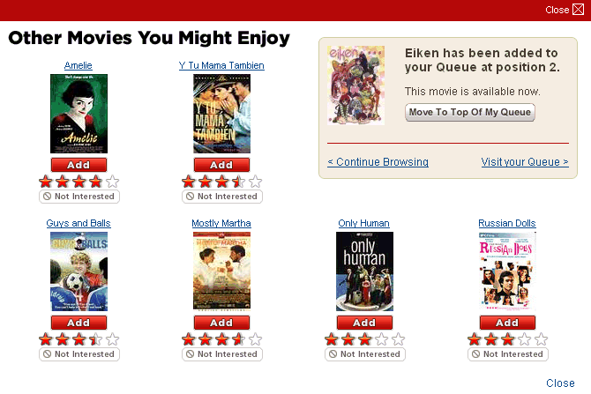

Slide 40
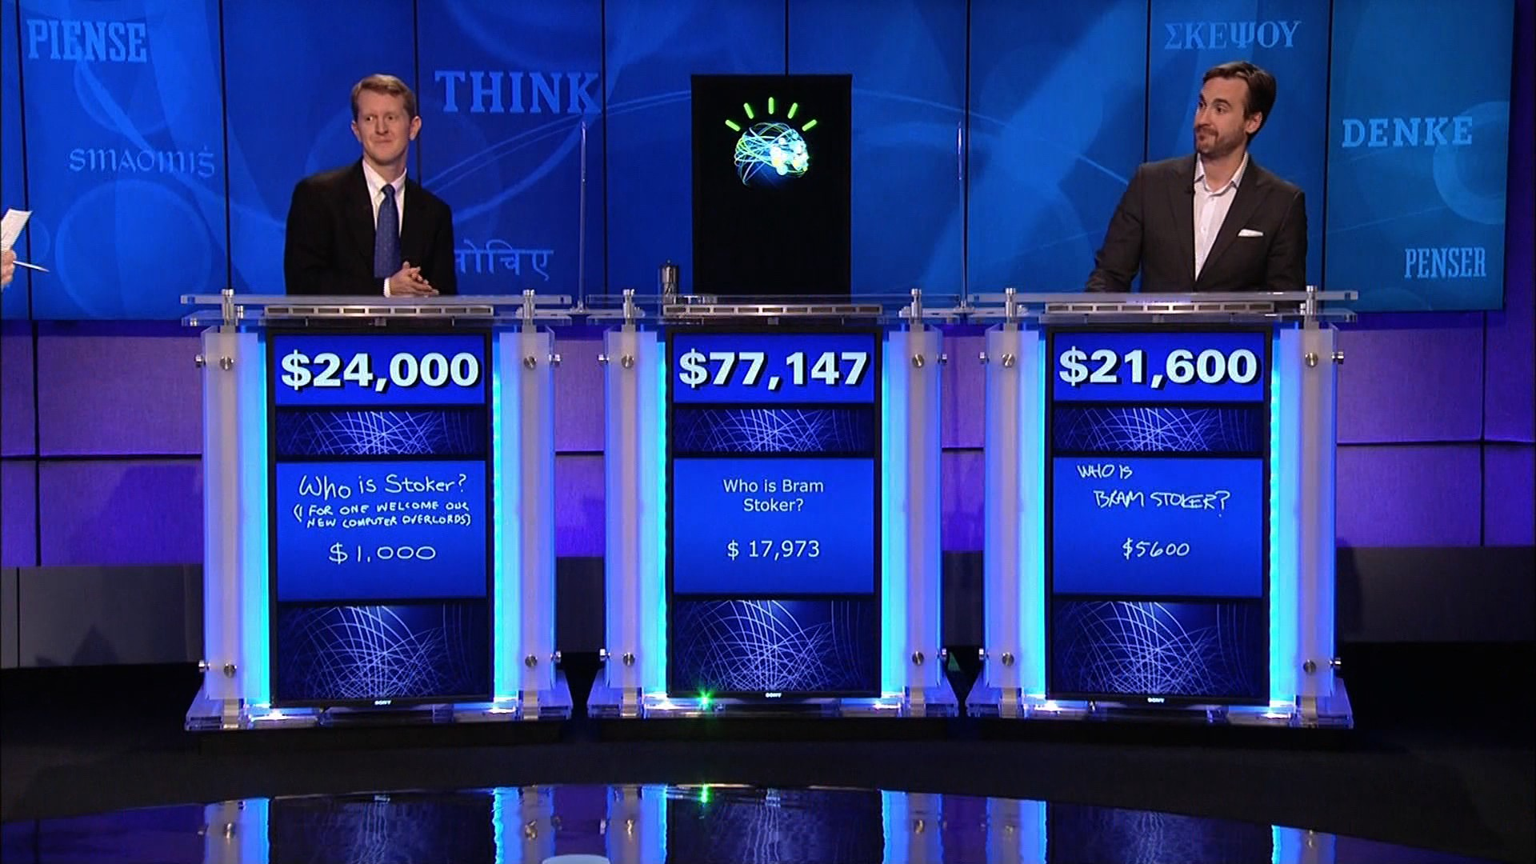

Slide 41
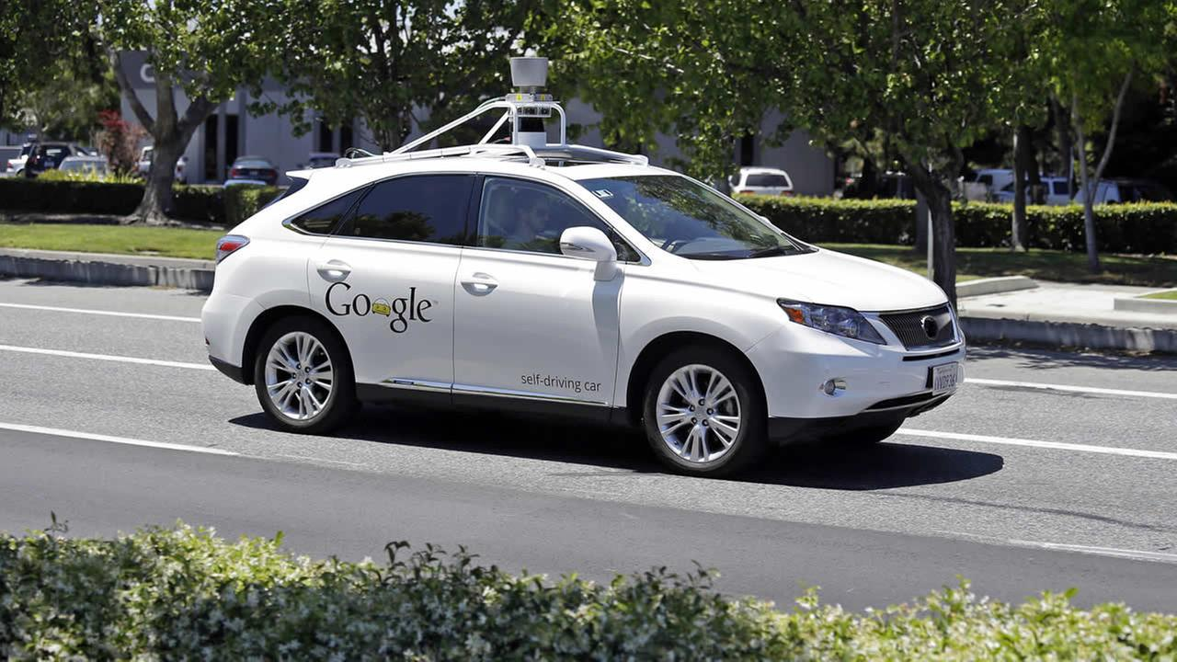

Slide 42
Computers can Learn

Slide 43
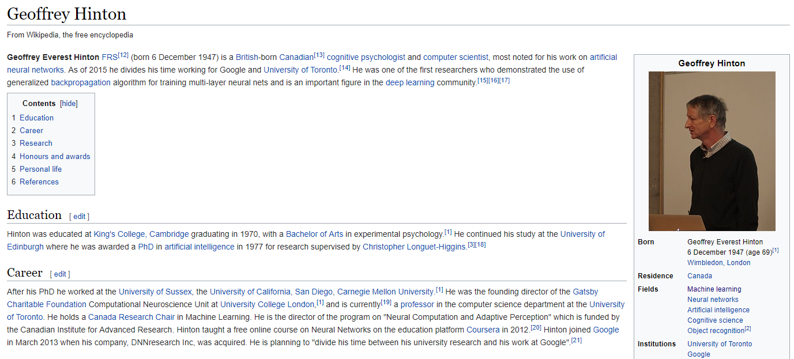
Automatic Drug Discover

Slide 44
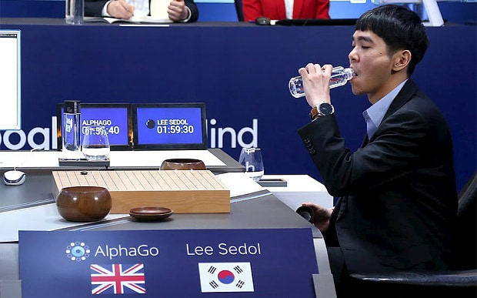
Google Deep Mind

Slide 45
Computers Can Listen And Understand

Slide 46
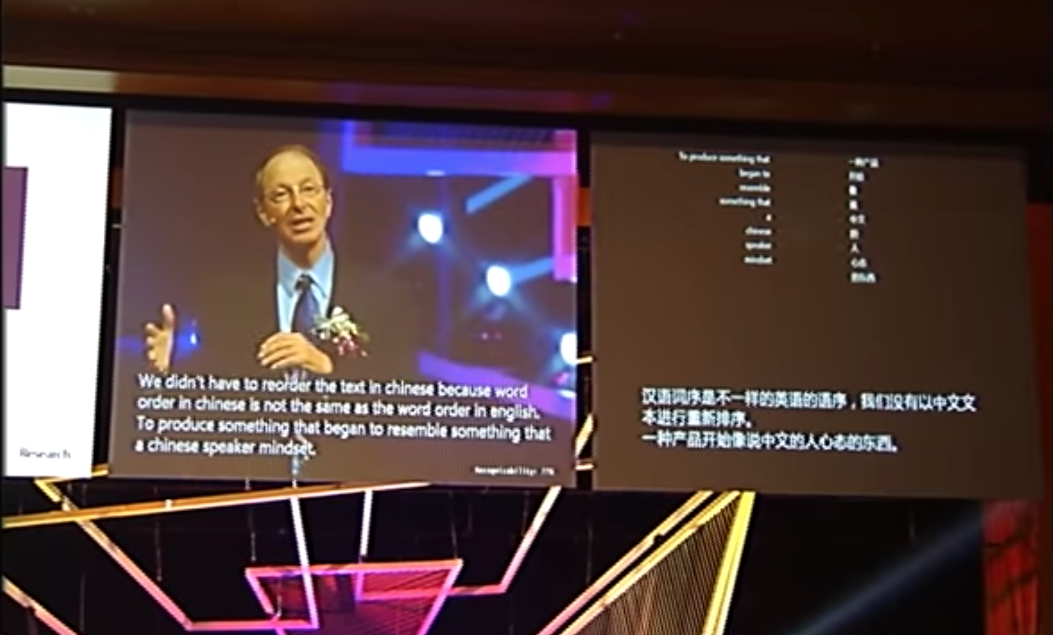
Speech Translation And Generation

Slide 47
Computers Can See

Slide 48
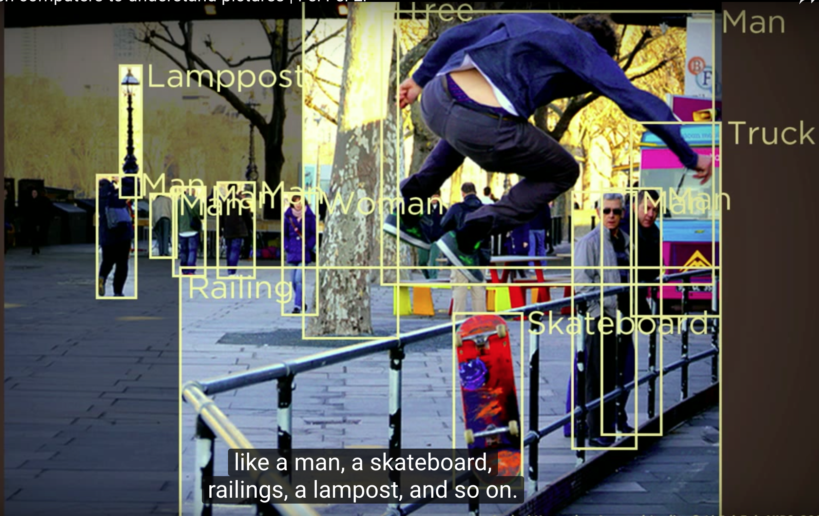
Image Recognition

Slide 49
Some Interesting things around AI
Artificial Intelligence created its own Movie
https://arstechnica.com/gaming/2016/06/an-ai-wrote-this-movie-and-its-strangely-moving/
Artificial Intelligence created its own Music
https://www.youtube.com/watch?v=3OEmzI52stk
Artificial Intelligence created its own Art
https://www.youtube.com/watch?v=Sbd4NX95Ysc

Slide 50
For Future

Slide 51
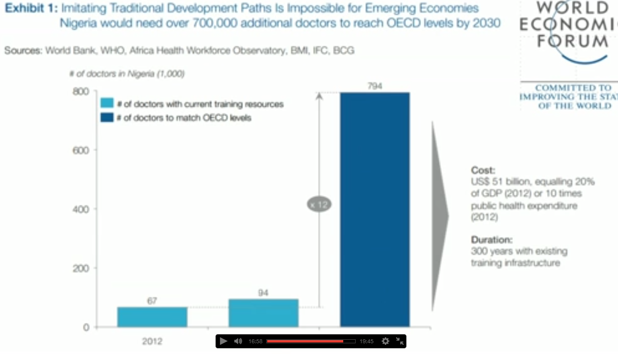

Slide 52
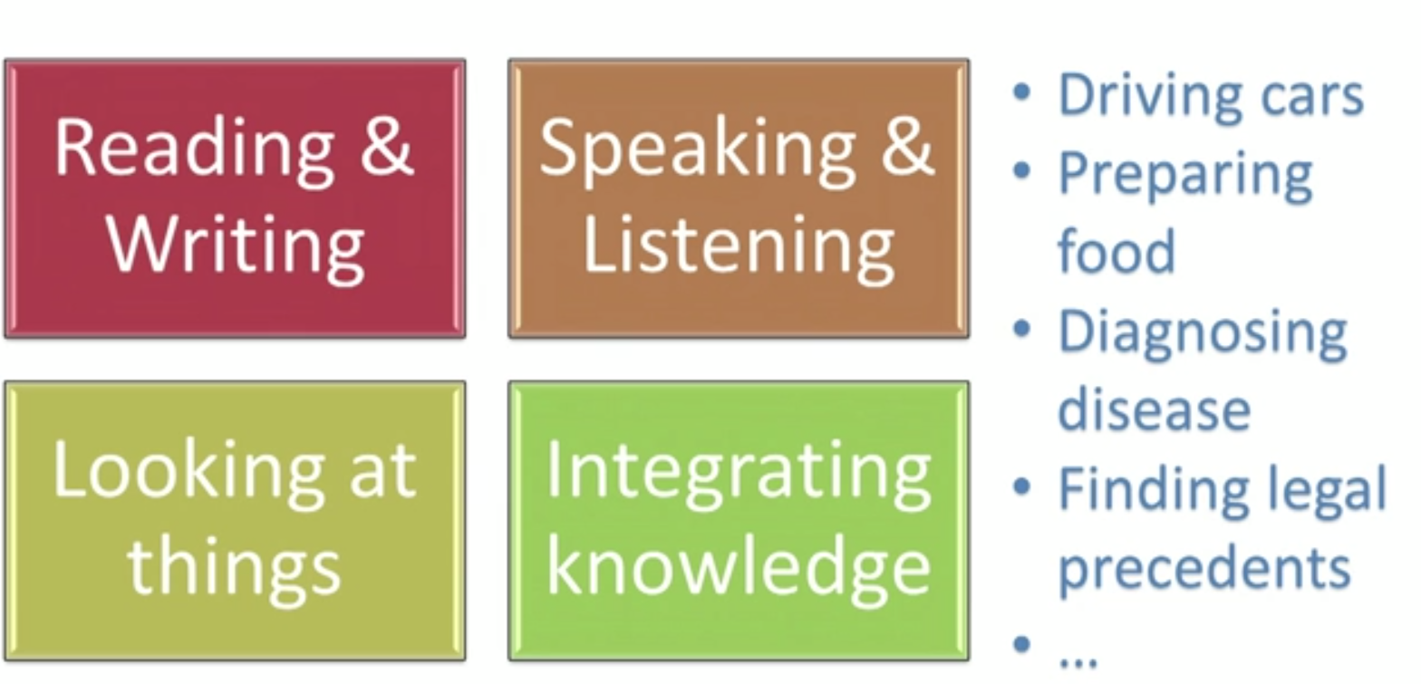

Slide 53
Future Jobs - Michio Kaku - Physicst
Those of Artificial intelligence can’t do
Pattern recognition and common sense are big problem of AI
Repetitive jobs will be wiped off
Jobs involved in intellectual capitalism will shine like
Leadership
Creativity
Analysis
Imagination
Telling joke
Writing a story, script

Slide 54
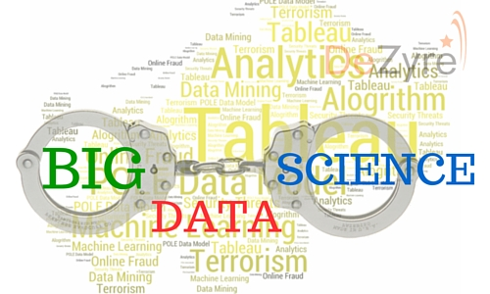
Big data and Data science are happily married

Slide 55


Make use of Kaggle and Analytics vidhya

Slide 56



Contribute your work to Opensource

Slide 57


Write a blog

Slide 58
References
https://www.ted.com/playlists/310/talks_on_artificial_intelligen
http://www.kdnuggets.com/
https://www.youtube.com
https://www.cubs100.org/GetImage.aspx?IDMF=ea11fbcd-1eb1-4829-9276-41f91b5bd75a&w=900&h=600&src=mc
https://securityledger.com/wp-content/uploads/2016/05/IBM-Watson.jpg

Slide 59
Syllabus
Python Basics
Python Libraries for Machine Learning
Statistics
Probability
Linear Regression
Logistic Regression
Naïve Bayes
KNN
Decision Tree
Random Forest
AdaBoost
Stacking
SVM
K-means, K-means++
Time Series
Deep Learning(Neural Networks, CNN, RNN)
Text Analytics

Slide 60
THANK YOU

